Slide 1
Tello
By:
Keerthana Pyata-1002029148
Alekya Bhavani Pentela-1002166050

Slide 2

How many members are having problems with their phone bill?

Slide 3

Introduction
Have anyone heard of plan as low as 5$ a month. Surprised!!!!!!! Yes that’s where Tello comes to light.
Tello is an online-only carrier that doesn’t operate any physical stores or even the actual cellular network it uses.
For cheap cell phone bills, Tello Mobile is definitely one of the top choices on the prepaid market right now.

Slide 4
Background
Tello Mobile is a Mobile Virtual Network Operator (MVNO) founded in 2016 that uses the T-Mobile network to provide talk, text, and data to its customers.
Founder: Florin miron

Slide 5

Parent Company
Tello Mobile moved current customers to the T-Mobile (GSM) network while continuing to support handsets running on the Sprint (CDMA) network.

Slide 6
Features of Tello
Plans and Pricing
Activation Process
Call and Text Performance
Data Speed
Customer Service

Slide 7
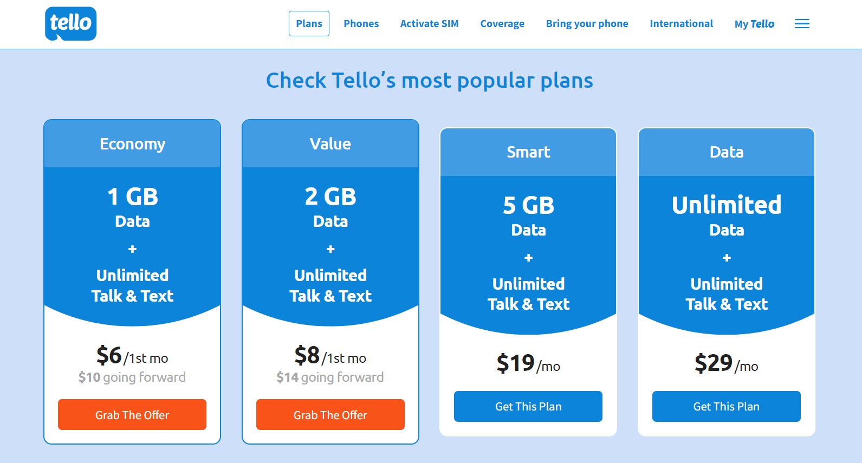
Features of Tello
Tello Mobile offers four ready-made plans including the cheapest overall monthly plan.
Economy
Value
Smart
Data
Plans and Pricing
Activation Process
Call and Text Performance
Data Speed
Customer Service

Slide 8
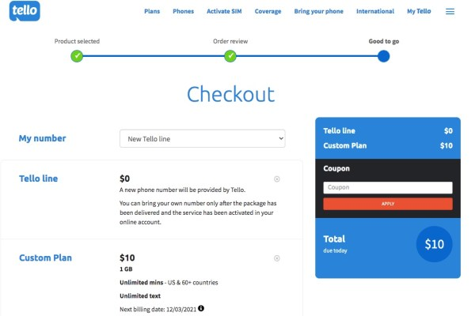
Features of Tello
Plans and Pricing
Activation Process
Call and Text Performance
Data Speed
Customer Service

Slide 9
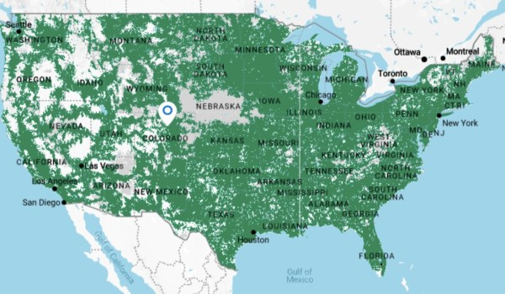
Features of Tello
Tello Mobile runs on T-Mobile’s network and the map below indicates coverage in many areas of the United States.
Plans and Pricing
Activation Process
Call and Text Performance
Data Speed
Customer Service

Slide 10
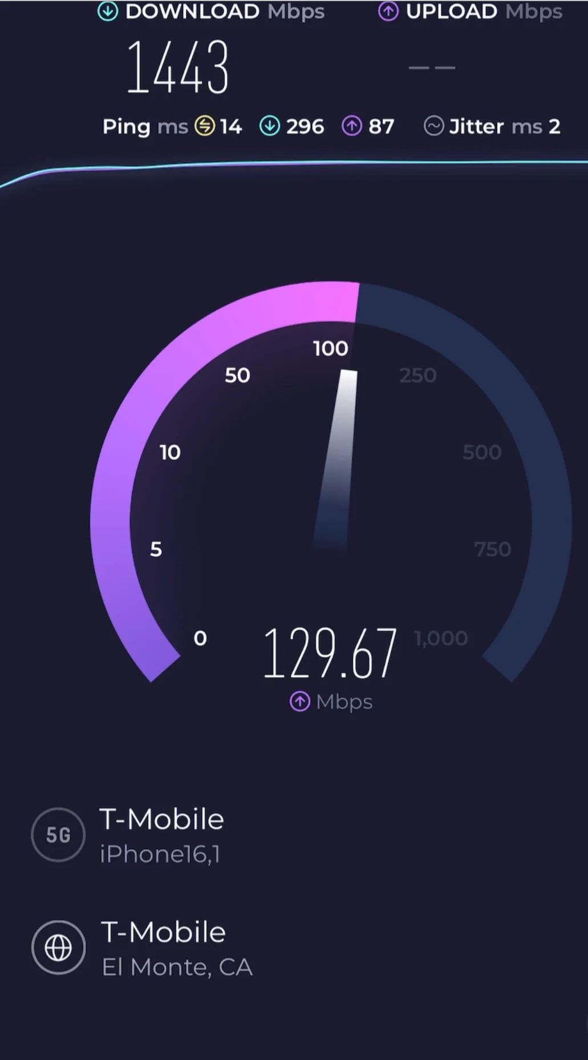
Features of Tello
The picture shows the data speed of Tello network runned on Iphone
Tello mobile offers access to T-Mobile’s 4G LTE/5G network
Plans and Pricing
Activation Process
Call and Text Performance
Data Speed
Customer Service

Slide 11
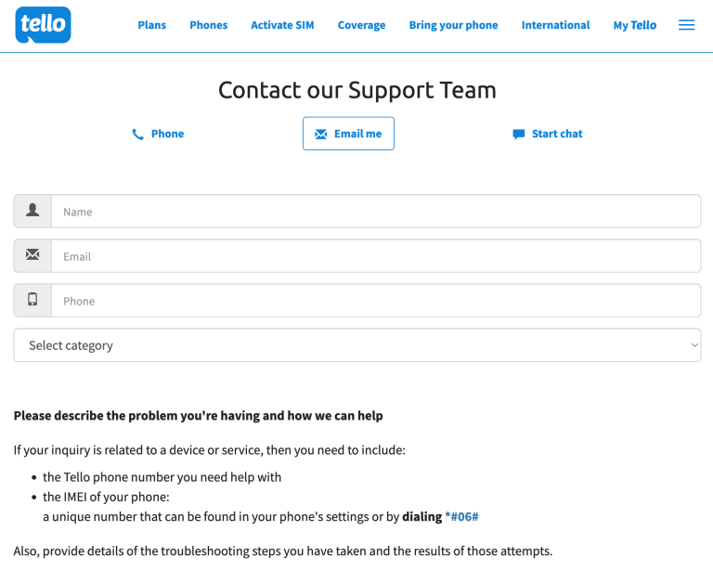
Features of Tello
Tello is an online-only company, which means there’s no store visit for customer support. Instead, you’ll have to contact Tello Customer Service online via chat or email or by phone.
Plans and Pricing
Activation Process
Call and Text Performance
Data Speed
Customer Service

Slide 12
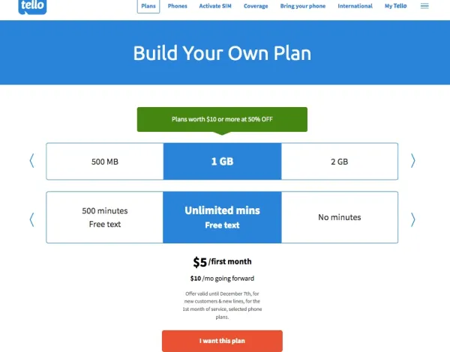
How Tello is Different
Coverage
Tello gives customers the chance to customize their plans to their needs.
Customizable Plans
Customer Service
Flexibility

Slide 13
How Tello is Different
Customer Service
No advance payment, no extra cost per line, no hidden fees or soul-sucking contracts. Pay for what you actually use.
No contract No fees
Flexibility
Customizable Plans

Slide 14
How Tello is Different
Flexibility
Tello stands out among the bunch by providing friendly and helpful customer service that has earned it high marks for customer satisfaction.
Tello has earned a 4.5-star rating from over 8,000 customers.
Customer Service
Customizable Plans
No contract No fees

Slide 15
How Tello is Different
Customizable Plans
Tello gives the flexibility and freedom to switch carriers whenever you want, but with the savings you get from Tello, you might not have any real reason to.
Flexibility
No contract No fees
Customer Service

Slide 16
Drawbacks
Unlimited data value
Tello’s 5G data allowance on its unlimited plan also caps out at 25GB per month, after which you’ll be reverted to 2G speeds. This isn’t quite as good as Mint’s allowance of 35GB per month, or Visible - which never caps out.
No family plan options
Tello’s cheap cell phone plan options are fantastic for kids, but unfortunately there are no bespoke family options or discounts if you’re looking for a multiple line solution.

Slide 17
Conclusion
Tello Mobile has generally been positively regarded for its affordable and flexible prepaid plans, no-contract model, and good customer service. Users appreciate the ability to customize their plans, bring their own devices, and experience cost-effective mobile services.
However, it's important to note that the mobile industry is subject to changes, and the information provided here might be outdated.

Slide 18

MCQs
1. What sets Tello Mobile apart from other carriers?
a) Exclusive smartphones
b) Customizable plans
c) Long-term contracts
d) Expensive data packages

Slide 19
MCQs
1. What sets Tello Mobile apart from other carriers?
a) Exclusive smartphones
b) Customizable plans
c) Long-term contracts
d) Expensive data packages

Slide 20
MCQs
2. Which carrier does Tello use?
a) Verizon
b) AT & T
c)T-Mobile
d)Spectrum

Slide 21
MCQs
2. Which carrier does Tello use?
a) Verizon
b) AT & T
c)T-Mobile
d)Spectrum

Slide 22
MCQs
3. Who is Tello owned by?
a) Keep Calling
b) Sprint
c)T-Mobile
d)Spectrum

Slide 23
MCQs
3. Who is Tello owned by?
a) Keep Calling
b) Sprint
c)T-Mobile
d)Spectrum

Slide 24
MCQs
4. Does Tello allows to prepare own plans?
a) Yes
b) No

Slide 25
MCQs
4. Does Tello allows to prepare own plans?
a) Yes
b) No

Slide 26
MCQs
5. Are there taxes and fees in Tello?
a) Yes
b) No

Slide 27
MCQs
5. Are there taxes and fees in Tello?
a) Yes
b) No

Slide 28


